Slide 1
BILLS OF MATERIALS
BOM

Slide 2
BILL OF MATERIALS-INTRODUCTION
Bill of material (BOM)-is a detailed list of all parts and subassemblies that are required to build a specific product, including the quantity necessary for each unit produced.
A BOM explains what to buy, how to buy and where to buy, and includes instructions for how to assemble the product.

Slide 3
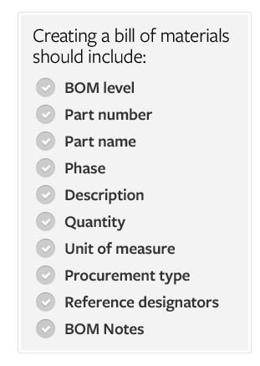

Slide 4
Types of BOM:
-engineering BOM
-manufacturing BOM
-configurable BOM
The different types of BOMs depend on the business need and use for which they are intended

Slide 5
ENGINEERING BOM
The engineering bill of defines the finished product as it was designed. The engineering BOM lists the items, parts, components, sub-assemblies and assemblies in the product designed by engineering. The engineering BOM is often organized by engineers based on a Computer-Aided Design (CAD) drawing.

Slide 6
MANUFACTURING BOM
The manufacturing bill of materials, contains all the parts and assemblies required to build a complete and shippable product. This includes all the packaging materials required to ship the finished product to the customer. The bill of materials will also include any processes that need to be performed on the item before it is completed. The manufacturing bill of materials stores all the information required for manufacturing activities.

Slide 7
CONFIGURABLE BOM
It is possible to have a bill of material for a finished product that can be configured to a specific requirement for a customer. The configurable bill of material contains all the components that are required to manufacture the material to a customer's specific requirements.

Slide 8
BILL OF MATERIALS-ECAMPLES
To manage what can be a tremendous amount of information, companies often use either Excel spreadsheets or a dedicated BOM management system like Arena PLM. We will present examples of how a bill of materials for a GPS navigation product would look in each system.

Slide 9
EXCELL SPREADSHEET EXAMPLES OF BOM
The great thing about using spreadsheets for your bill of materials is that they are flexible and can be formatted however you like. The bad thing about using spreadsheets for BOMS is that they are flexible and anyone can format them however they like, often resulting in inconsistencies across a company’s BOMs.

Slide 10
EXAMPLE OF A BASIC EXCELL BILL OF MATERIALS
The basic BOM format separates information into columns. It contains BOM level, part number, part name, revision, quantity and reference designators.
It is helpful to have unit of measure and BOM notes on a bill of materials as well. The first line, with a BOM level of zero, is the top-level product or assembly to which everything else in the bill of materials reports.

Slide 11
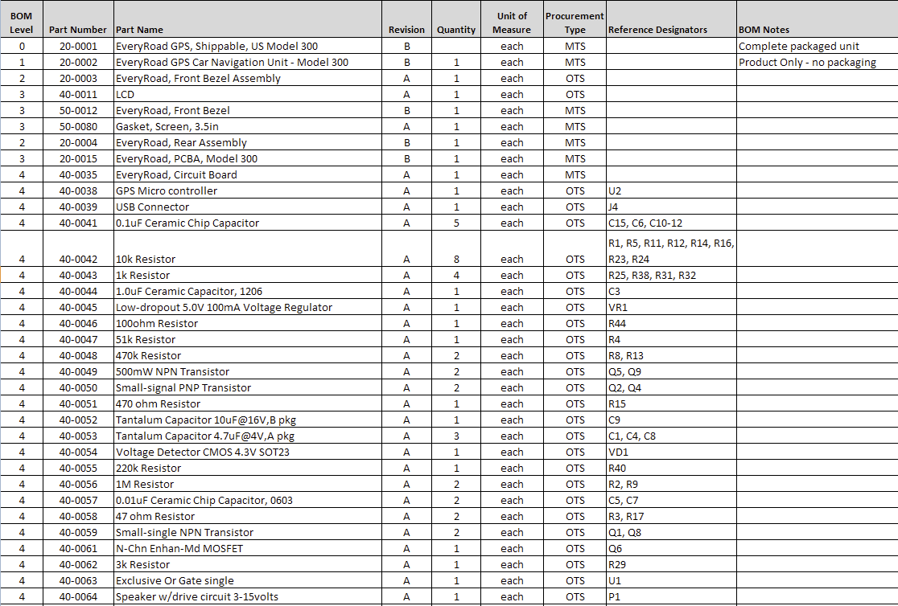
EXAMPLE OF A BASIC EXCELL BILL OF MATERIALS

Slide 12
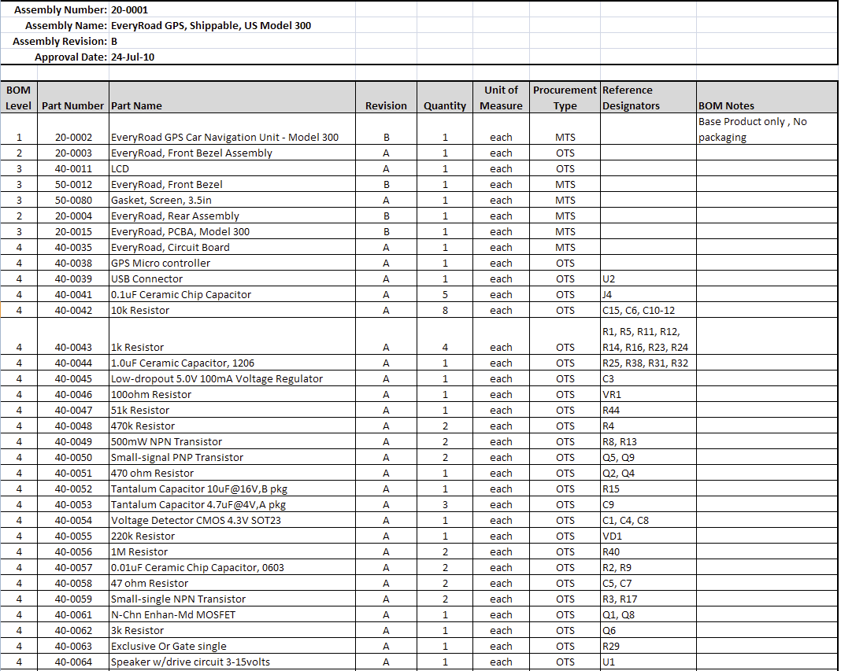
EXAMPLE OF AN EXCELL BILL OF MATERIALS WITH A HEADER

Slide 13
EXAMPLE OF AN EXCELL BOM WITH GRAPHIC REPRESENTATION OF ASSEMBLY LEVEL
The third example uses a graphical element to show parts’ relative positions within the BOM. Users can quickly scan bills of materials and understand where particular parts are located when each level is denoted with a marker (e.g. a star).
The numerical BOM level is included too. With the correct Excel formula, this number can automate the placement of the visual marker in the correct column.

Slide 14
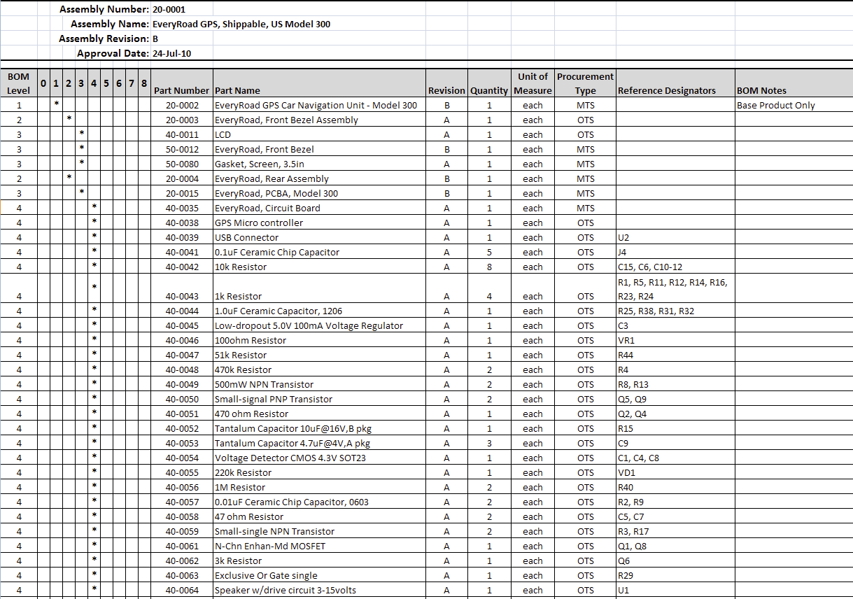
EXAMPLE OF AN EXCELL BOM WITH GRAPHIC REPRESENTATION OF ASSEMBLY LEVEL

Slide 15
BOM EXAMPLE IN ARENA PLM
As a cloud-based solution, Arena PLM differs from Excel in some significant ways. The Arena PLM product uses a database, which allows quick reconfiguration of information and an unlimited number of one-to-many and many-to-many relationships. It also allows for complementary information, like drawings, part specifications and supplier options, to be included in a BOM without additional overhead. Here are some examples of how the same GPS navigation bill of materials can look in Arena PLM.

Slide 16
INDENTED BOM IN ARENA PLM
An indented BOM in Arena PLM contains all the same information as an Excel BOM: part name, part number and quantity information. However, the Arena BOM can be exploded or collapsed at each assembly level in order to see more or less depth as needed. It also includes links to more detail on individual subassemblies, parts and files.

Slide 17
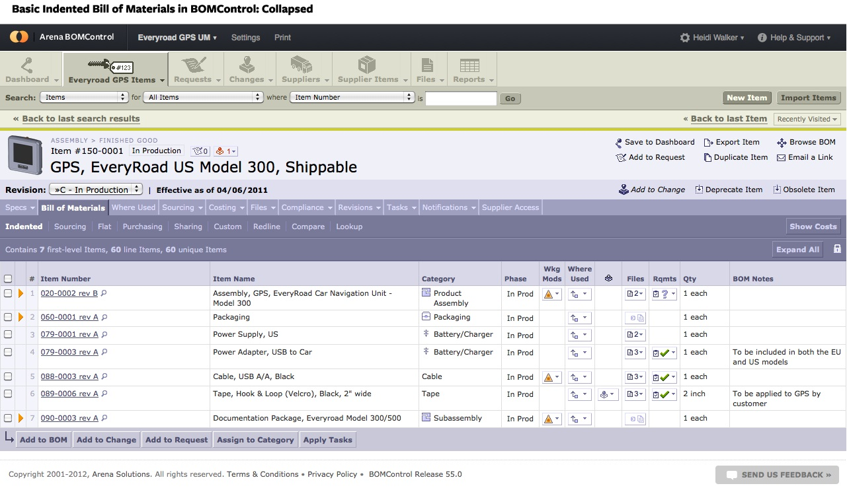

Slide 18
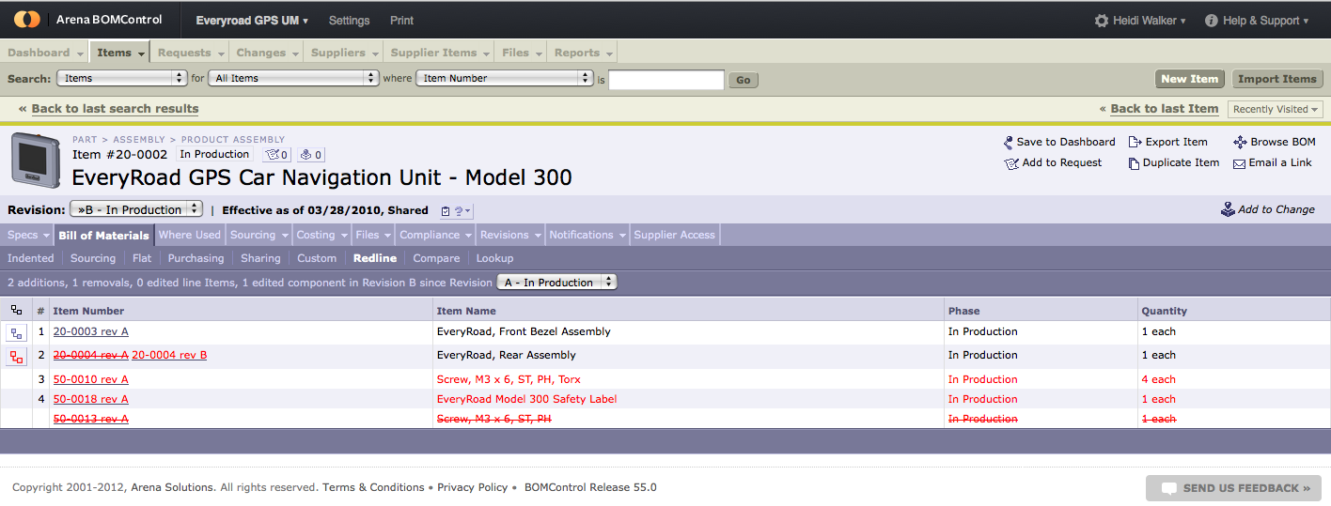
COMPARING DIFERRENCES IN BOMs IN ARENA PLM

Slide 19
COMPARING DIFERRENCES IN BOMs IN ARENA PLM
The redline BOM view in Arena PLM offers a clear visual comparison of two revisions of a bill of materials. Additions and deletions are shown in red. The revisions being compared can be adjusted through the revision drop-down menu.
The BOM comparisons view in Arena PLM has built-in capabilities that allow the differences between two similar BOMs to be easily compared. Item lines with differences are marked with red arrows on the left and those differences are marked in red on the right.

Slide 20
PDXpert PLM SOFTWARE
Another example of software is PDXpert PLM .
PDXpert PLM has been specifically designed for smaller organizations making the transition to automated product structure management. It's easy for users to find their items using free-form text search, then create complex products by simple drag-and-drop BOM construction.

Slide 21
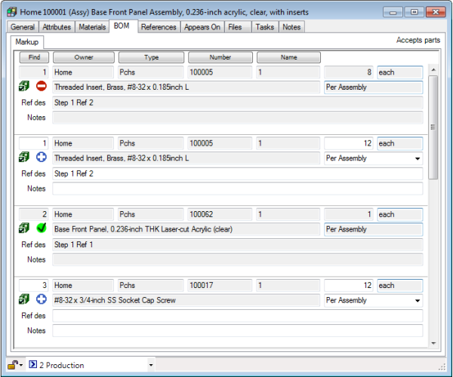
PDXpert PLM

Slide 22
FEATURES OF PDXpert
Parts, manufacturing attributes, materials
Assembly bill of materials (BOM): structures, sources, and their markups
Documents, revision control and controlling organizations
Library for managing electronic design & data files; includes indexed, searchable file content
Engineering change forms with workflow rules
Item Explorer: New & recently-used, free-form text search, tasks & checked-out files
Configuration collections for tailoring PDXpert to your requirements
Robust architecture scales from single user to mid-sized company

Slide 23
COLLABORATIVE & INTELLIGENT BOM MANAGEMENT SOFTWARE-CIIVA
It is free
Working in cloud
Working on the same document at the same time by mny workers
Saving informations about person who changed a BOM
Not much virtual space as commercial versions of programs

Slide 24
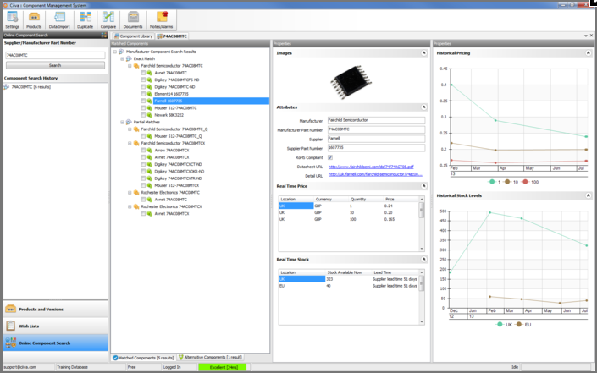

Slide 25
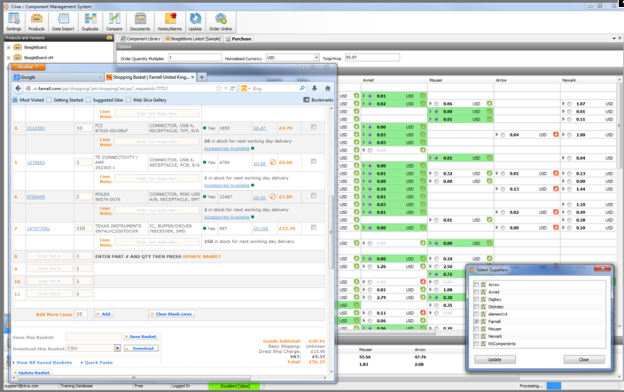

Slide 26
BOM MANAGEMENT SOFTWARE- SILICON EXPERT
E-mail alerts
Product lifecycle algorythms
Health reports (red flags)
Environmental complience data
Copying data to another formats (e.g. Excel)

Slide 27
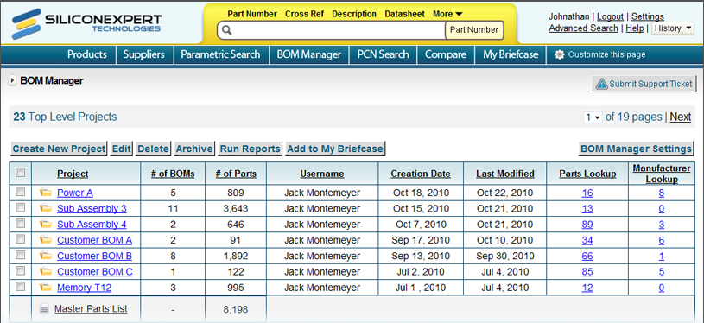

Slide 28


Slide 29
ADVENTAGES AND DISADVENTAGES OF BOM
There are many pros for using „Bill of Materials” applications. A few cons are also associated with inventory management software, but these cease to be a problem if they are dealt with in a proper manner. Moreover, if you use one of the best inventory software applications in the market, you probably would not have to deal with the disadvantages.

Slide 30
ADVENTAGES OF BOM SOFTWARE
Flexibility
Ability to format spreadshits however you like
Saving time
Reduction in Costs
High Efficiency

Slide 31
DISADVENTAGES of BOM SOFTWARE
Being dependent on computers
Flexibility can also be disadventage -anyone can format them however they like, often resulting in inconsistencies across a company’s BOMs
Price
Complexity

Slide 32
SUMMAR
-you don’t have to use calendar or piece of papers to notice bills of materials
-wide assortment of computer programs
-cloud solutions
-a lot of workers can use the same list at the same time- real time actions

Slide 33
THE END

